Slide 1
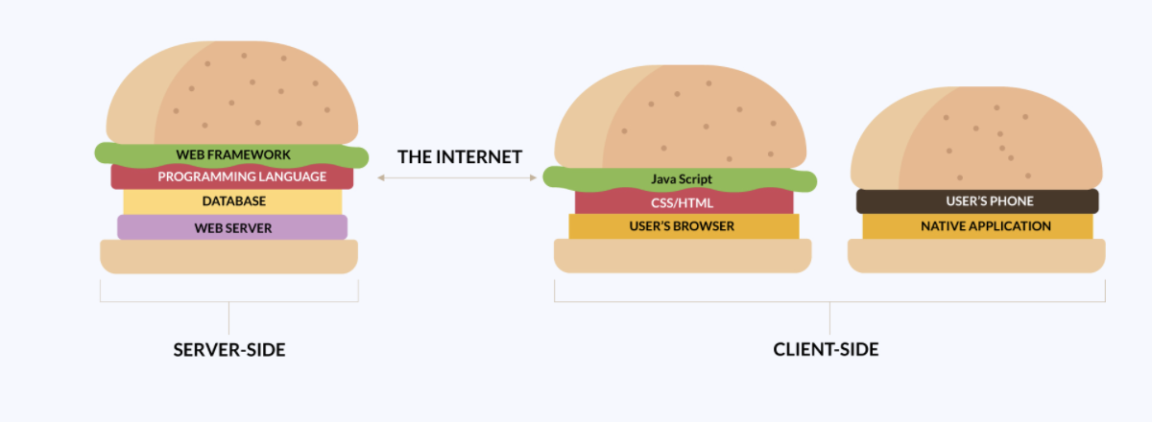

Chapter2. Intro Java Language Features
@Lei; 4th, Dec. 2021
Warm-up
Self-introduction:
Personal site
Classes
…
Industry:
By market cap
By Tech Stack:
Structures
Technologies

Slide 2
Resources
Barron’s AP, 9e, Roselyn Teukolsky, M.S.
Code: https://github.com/lei-hsia/ap
Create your Github account
Princeton University JavaSE
(Additional)
Install Java on your computer(link above)
Java archived version: Java download: (Java8/11 recommended)
(Additional: Columbia University CS1004 introduction)

Slide 3
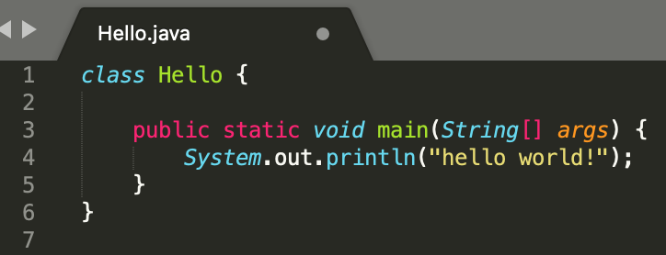
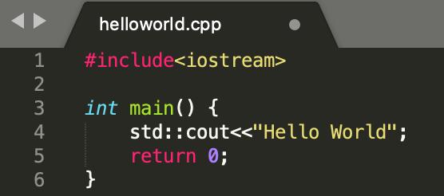
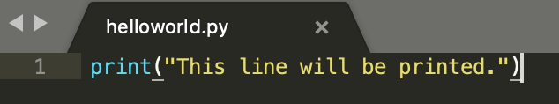
Packages and Classes
class: blueprints (#class>=1; main)
package: a bunch of classes(user-defined or from libraries)
e.g. 101:
Programming in Java
- Write your source code, e.g. MyProgram.java
- Compile it: "javac MyProgram.java” in terminal
- Execute(run) it: "java MyProgram” in terminal

Slide 4
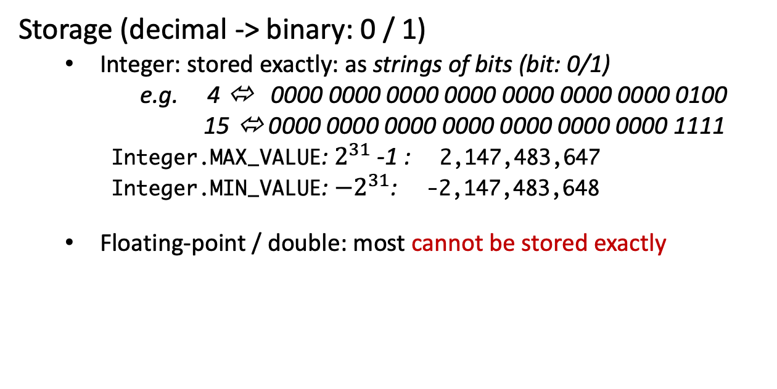
Types and Identifiers
Casting:
Implicit casting:
int num1 = 3;
double real1 = num;
Explicit casting:
final double PI = 3.14;
int num2 = (double) PI;
Wrong:
double x = 7.99;
int y = x;
Primitive types:
int: 32-bit /4 bytes
long: 64-bit / 8 bytes
float: 32-bit (never use for money)
double: 64-bit (never use for money)
boolean: 1-bit: true/false
char: 16-bit
Storage (decimal -> binary: 0 / 1)
Integer: stored exactly: as strings of bits (bit: 0/1)
e.g. 4 ⬄ 0000 0000 0000 0000 0000 0000 0000 0100
15 ⬄ 0000 0000 0000 0000 0000 0000 0000 1111
Integer.MAX_VALUE: $2^{31}$ -1 : 2,147,483,647
Integer.MIN_VALUE: ${−2}^{31}$: -2,147,483,648
Floating-point / double: most cannot be stored exactly

Slide 5
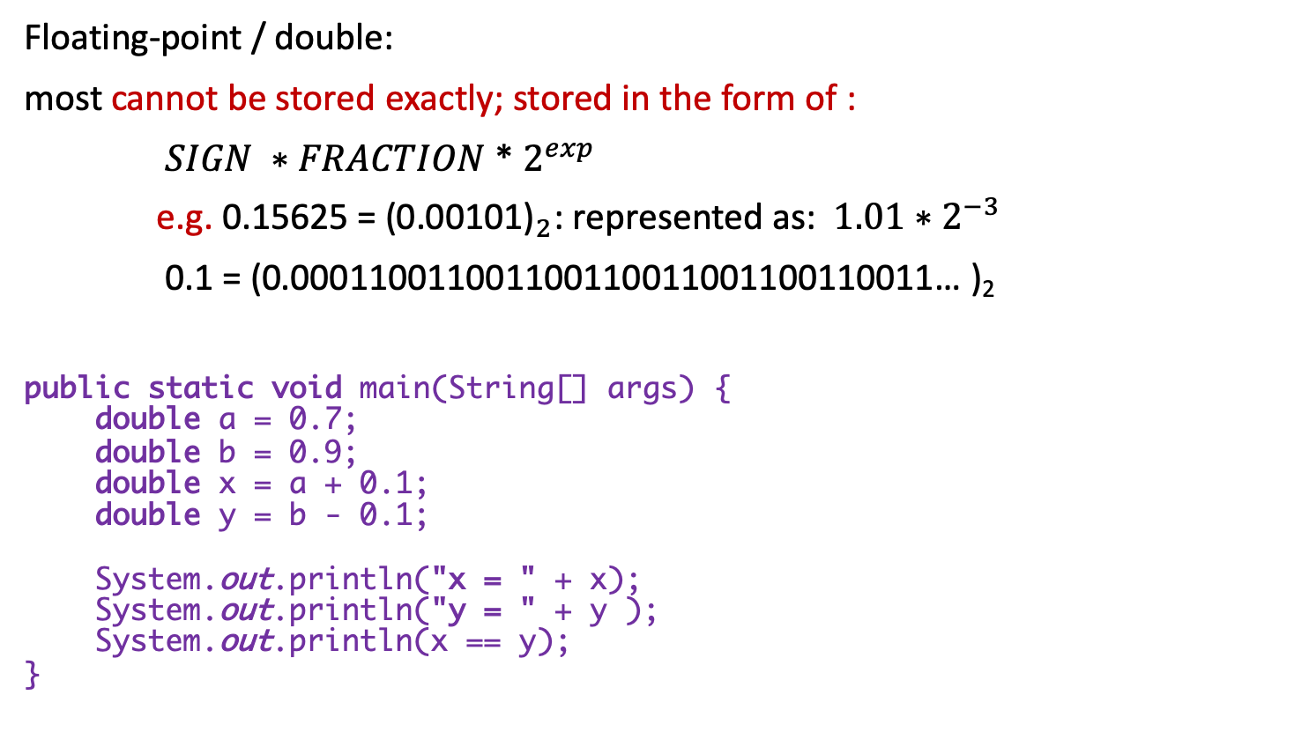
Types and Identifiers(Cont.)
Floating-point / double:
most cannot be stored exactly; stored in the form of :
$SIGN ∗FRACTION$* $2^{exp}$
e.g. 0.15625 = ${\text{(0.00101)}}_{2}$: represented as: $1.01∗$ $2^{−3}$
0.1 = (0.000110011001100110011001100110011… )₂
public static void main(String[] args) { double a = 0.7; double b = 0.9; double x = a + 0.1; double y = b - 0.1; System.out.println("x = " + x); System.out.println("y = " + y ); System.out.println(x == y); }
x = 0.7999999999999999
y = 0.8
false

Slide 6
Operators
Arithmetic operators: + - * / %
integer division;
mod(reminder vs quotient)
Relational(Comparison) operators:
== != < > >= <=
boolean flag = (a != b);
“SomeString”.equals(strVar)
Logical operators
short-circuit evaluation
Question:
if (n != 0 && x + n > 100) (n = 0, x=200)
statement1;
else
statement2;
Executed: statement2
/ | division | 3.0/4; 3/4.0; 3 / 4; (int) 3.0/4; (double) 3 / 4
% | mod | 7 % 4 = 3 (reminder);
Integer division:
7 / 4 = 1; 7 % 4 = 3
! | NOT | if (!CollectionUtils.isEmpty(array))
&& | AND | if ( target > someThreshold && flag)
|| | OR | if (num != 0 || x / n > 100)

Slide 7
Operators(Cont.)
Question: assignment: how to swap value of 2 integer variables?
int a = 2, b = 3;
Assignment operators
Increment/decrement operators.
= | x = y | assign
+= | x += 4 | x = x + 4
-= | y -= 5 | y = y - 5
*= | m *= 2 | m = m * 2
/= | n /= 5 | n = n / 5
%= | k %= 10 | k = k % 10
int tmp = 0; tmp = a; a = b; b = tmp;
! ++ --
* / %
+ -
< > <= >=
== !=
&&
||
=, +=, -=, *=, /=, %=
Operator Precedence
(High to low)
1. NOT, incr/decr
2. Arithmetic
3. Comparison
4. AND, OR
5. Assignment
++ | ++k or k++ | increment k by 1
-- | --k or k -- | decrement k by 1

Slide 8
Control Flow
if (boolean expression1) {
if (boolean expr2) {
statement1
} }
else if { statement2 }
else if {
statement3
} else {
statement4
}
{ }: one-line: can be omitted
more than one-line: cannot be
C (A is correct)

Slide 9
Control Flow(Cont.)
for loop(enhanced for loop)
for (initialization; terminal condition; update statement) {
statements
}
for (SomeType element : collection) {
statements
}
while loop
while (boolean test) {
statements
}

Slide 10
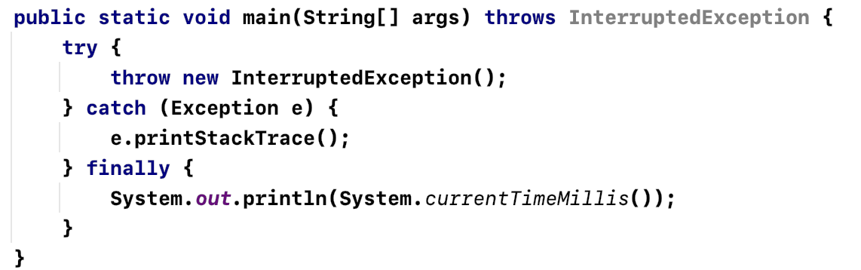
Exceptions
Exceptions: error conditions that occur during Java program.
Unchecked exceptions: automatically handled by JVM
Checked exceptions
(Not required)
throws
throw
try…catch…finally
ArithmeticException
NullPointerException
ArrayIndexOutOfBoundsException
IndexOutOfBoundsException
IllegalArgumentException
ConcurrentModificationException

Slide 11
In/Out (I/O)
AP:
Input: double x = … ; // read user input
Output: System.out.print ; System.out.println
Escape sequence: \n; \”; \\
Real example: Scanner (not required)
public static void main(String[] args) { Scanner in = new Scanner(System.in); System.out.print("Enter your name: "); String name = in.nextLine(); System.out.println("Name is: " + name); in.close(); }
\n | Newline
\” | Double quote
\\ | backslash

Slide 12
Summary
Packages and Classes
Types and Identifiers
Operators
Control flow
Exceptions
In/Out
Q & A

